Slide 1
EE209 - Fundamentals of Electrical & Electronics Engineering
Dr. M. Mert ANKARALI

Slide 2
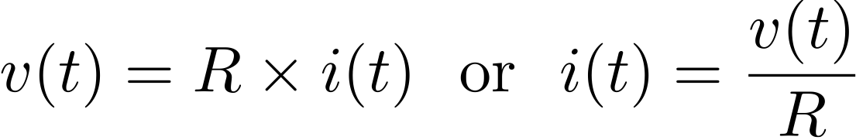
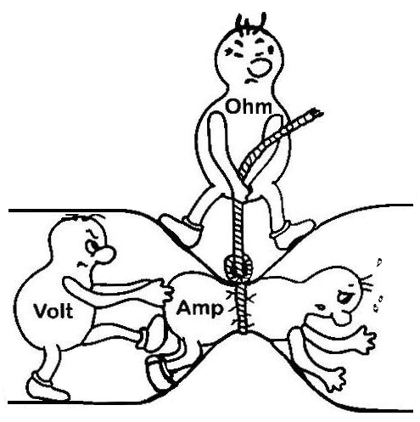
Ohm’s Law
There is a static/memoryless linear relationship between the flow current and voltage drop across a resistor

Slide 3
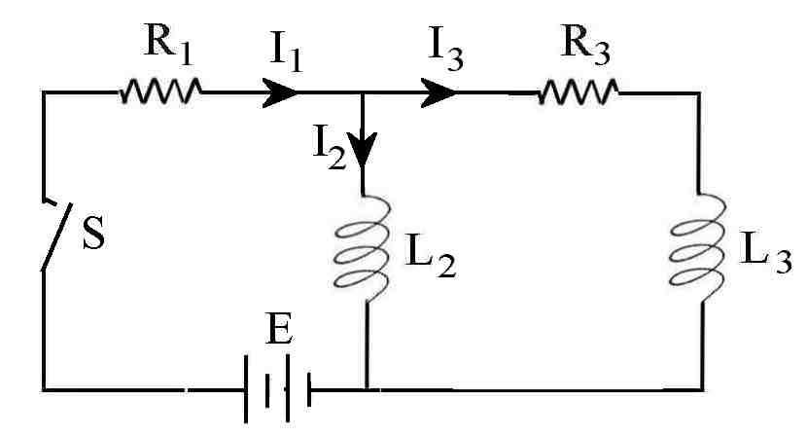
Terms in circuit diagrams
Node: Point of connection between elements
Branch: Connection between two nodes
Loop: Closed loops in circuit diagram

Slide 4
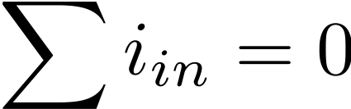
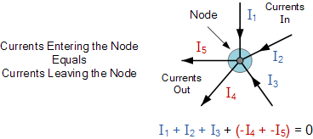
Kirchhoff's Current Law
Algebraic sum of currents entering a closed a node (or a loop) is zero

Slide 5
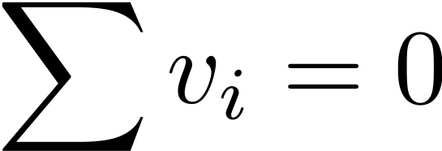
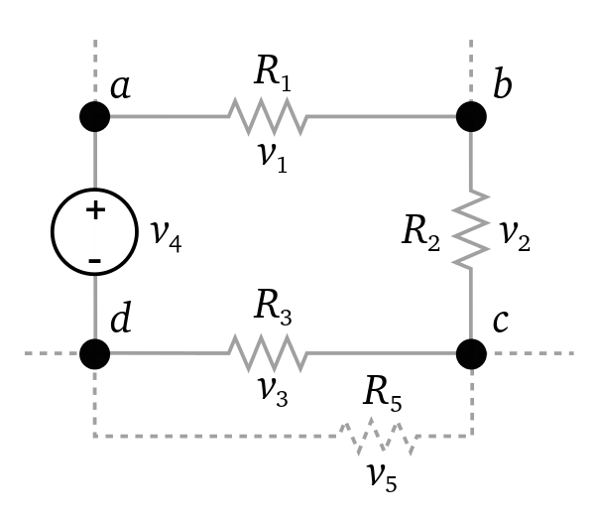
Kirchhoff's Voltage Law
Algebraic sum of all voltages around a closed path (or loop) is zero.

Slide 6
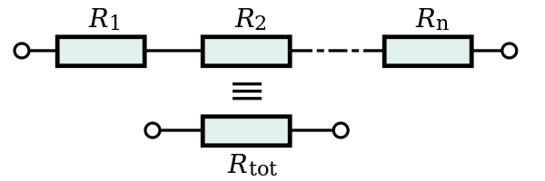
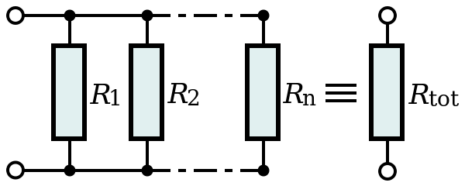
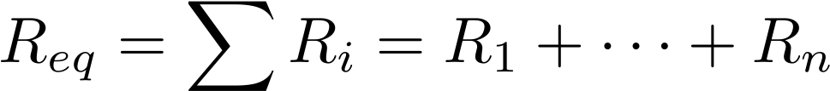
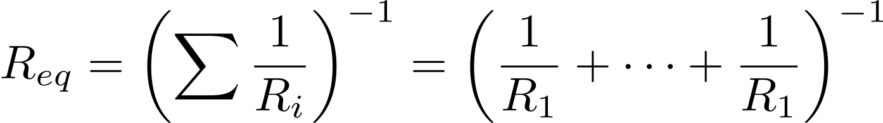
Series resistors

Slide 7
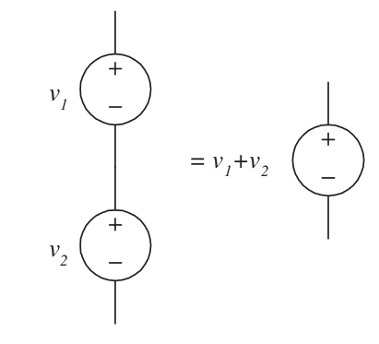
Connection of Voltage Sources
Series voltage

Slide 8
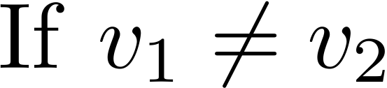
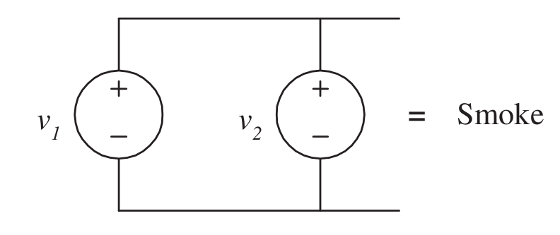
Connection of Voltage Sources
Parallel voltage

Slide 9
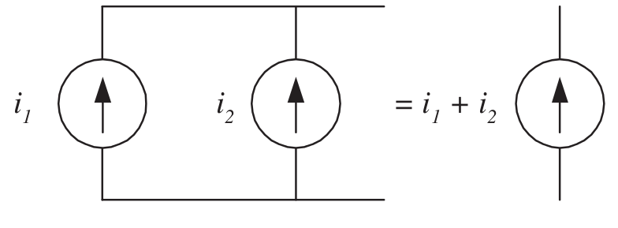
Connection of current sources
Parallel current source

Slide 10
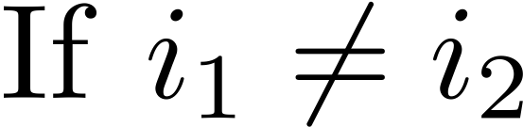
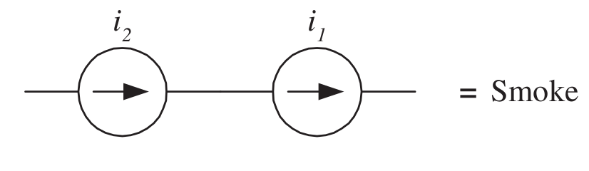
Connection of current sources
Series current source

Slide 11
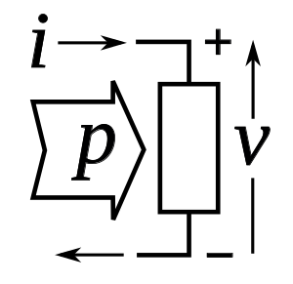
Passive sign convention
(Passive) resistors cannot produce power, only consumes it !
!Current enters the positive voltage terminal

Slide 12
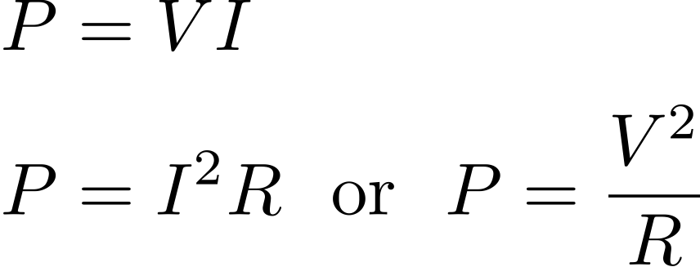
Power
(Passive) resistors cannot produce power, only consumes it !
Absorbed Power for a Resistor > 0

Slide 13
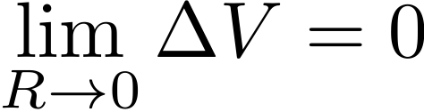
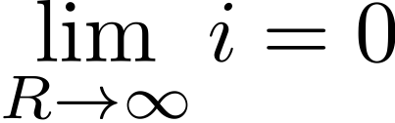
Short/Open circuit
Short circuit: Resistance & voltage drop
Open circuit: Resistance & current

Slide 14
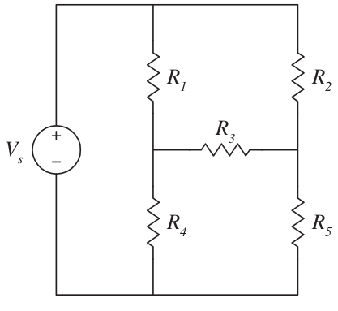
Can you find the equivalent resistance?

